Slide 1
Data Operations Global Webcast
November 9, 2017

Slide 2

The puzzle is almost complete ...

Slide 3
Objectives for this webcast
  Share progress on the ongoing Data Operations transformation effort
  Update on the n-4 organizational design
  Outline the recruitment process for the remainder of DO organization
  * n: Vas Narasimhan, n-4s are the direct reports of the Data Operations LT

Slide 4
RECAP: Data Management & Statistical Programming: focus areas
  Simple
  Standardized
  Internal
  Customer
  Focused
  Program-focused
  Efficient
  Rapid
  Scalable
4

Slide 5
RECAP: together we are stronger…
Current
oversight
SDTM-
Production of outputs
Ad hoc
project support
Final submission support
Data Management
Statistical Programming
DB
design
Data
processing
Data Integration / transformation
Data
provision
oversight
AdAM
Future
oversight
Data Operations
DB
design
Data
processing
Data Integration / transformation
Data
provision
Prod
of outputs
Ad hoc
project support
Final
submission support
AdAM
SDTM

Slide 6
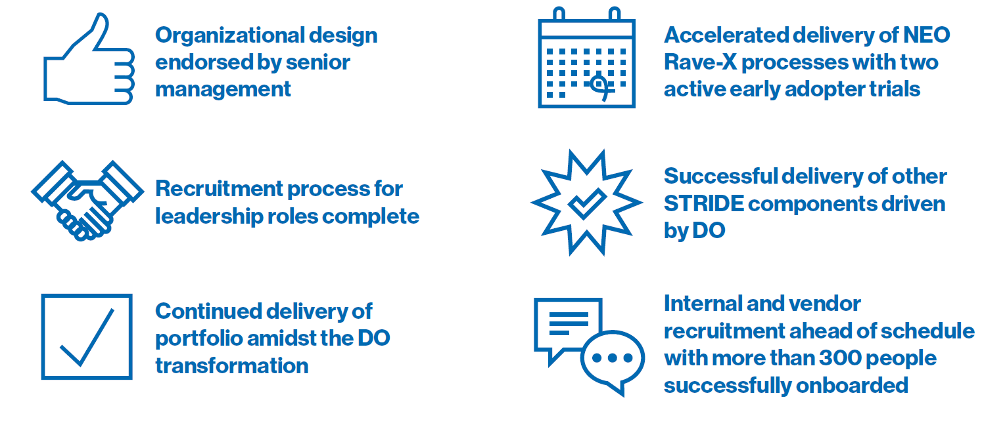
What success looks like..

Slide 7
Our achievements (Q3 / Q4)

Slide 8
UPDATE : DO transformation
Mid ‘16
2017
Mid ‘18
Footprint
shift to HYD
  Moving positions from EH/BS to HYD
    EH, confirmed 18 May
    BS, confirmed 11 Sep
  Build up Hyderabad
  Establishing support via 3rd party vendor
1
  Jul
  Mar
  May
Vendor
consolidation
  Consolidating FSP activities from 11 vendors to 2 vendors: ICON and GCE
  Transition from an FSP pricing model to a unit based pricing model
2
  Jan
  Feb
  Mid
Single DO org design
  Continue to combine ONC/ Genmeds/ALCON/ Sandoz into a single org structure
  Consolidating DM and SP activities under one Data Operations umbrella
  May
3
  Jun
  Sep
  Dec
  Kick-off
  Endorsement
  Completion

Slide 9
Global DO organization
US/CH
18
Ind / Others
803
Total
821
Externals (tbc)
641
Data Operations
Dermot Kenny
821
Dev
Units
Olivier Leconte
Data management
Sarah Clark
Statistical Programming
James Gallagher
Clinical database
delivery
Raghu Thata
Data provisioning and analytics
Ramesh V
a.i.
22
303
296
74
54
Training, Operations and Process Improv
Leianne E
Japan
Shinji Nishida
China
Wei J Chen
Clinical data
standards
Simon Walsh
Innovation and Technical Implementation
TBD
31
1 (32)*
1** (29)*
33
6
  * Other FTEs in JP and CN included in the DM and SP organization numbers
  ** China head double counted in SP organization figure

Slide 10
Objectives for this webcast
  Share progress on the ongoing Data Operations transformation effort
  Update on the n-4 organizational design
  Outline the recruitment process for the remainder of DO organization
  * n: Vas Narasimhan, n-4s are the direct reports of the Data Operations LT

Slide 11
RECAP : Talent selection objectives for 41 n-4 roles
Ensuring an inclusive pool of candidates (relevant profiles from all legacy functions will be considered)
Implementing with no disruption to the business: only new roles or those undergoing substantial change will be in scope for selection to preserve business continuity and knowledge transfer. Unchanged roles will be mapped directly
Providing transparent, fair, robust, rigorous and objective processes
1
2
3

Slide 12
3 differentiated selection processes, 41 n-4 positions, 37 confirmed
Rationale
Process
Positions
Selected
Mapping
Unchanged or slightly changed roles where there is one incumbent
Direct appointment of an incumbent into the new role
Mapping does not preclude candidates to apply to other roles
1
12
11
1 position to be opened (DM)
Closed
  New or significantly changed roles where there is a discrete population of suitably qualified / experienced incumbents
  Direct contact with the relevant associates and conduct a closed recruitment process, standard interview process (no internal/external advertisement
  Identified candidates will be invited to a follow up meeting in the coming days
12
11
2
1 position to be confirmed by the Workers Council in Germany (DODU)
Open
New or significantly changed roles where there are no incumbents or many potential incumbents
Selection process initially internally via Brassring
Externally only if we fail to identify a suitable internal candidate
17
15
3
1 position to be opened (CDP&A)
1 US position to close (CDS)

Slide 13
DO Development Units
n-4 distribution
Basel / EH
4
DO Portfolio
Management Head
Olivier Leconte
HYD / Others
5
Total
9
DO Cardio Metabolic Director
Sangeeta Bhattarcharya
DO Oncology Head
Guillaume Breton
DO Sandoz/ Alcon Director
TBA (Germany)
DO NIBR
Director
Francois Langlo
DO GMA
Director
Sri Vithala
Data Integration & PMX Director
Gregory Pinault
DO Resp & Established Meds Director
Sreesha Nair
Solid Tumors
Alcon
NIBR TCO
GMA Pharma
& Others
PBX Analysts
Haematology
PBX Analysts
DO Immunology & Dermatology Director
Gargi Paigaonkar
Rare and Other diseases
PBX Analysts
(external)
DO Neuroscience & Ophtha Director
Michael Ball
Sizing criteria
DO Directors (n-4 and n-5) will handle an average of 3-5 projects in/post submission + Phase II / III projects

Slide 14
Data Management
n-4 distribution
Basel / EH
0
HYD / Others
5
Total
5
Global Head
Data Management
Sarah Clark
Cluster A
Sr Group Head,
S. Tumors, Resp, EM
Arun Patnaik
Cluster B
Sr Group Head,
Hematology, CM
Srinivas Hiriyanna
Cluster C
Sr Group Head, Rare and other diseases (Onc), I&D
Jagadeesh Rudraswamymath
Cluster D
Sr Group Head,
ED, NS, Ophtha, Alcon
Srikrishnan Talluri
CoE
Sr Group Head,
Specialized Services*
TBA (Hyderabad)
Cluster : A cluster is a collection of associates working on a specific set of TAs / franchises aiming to provide further flexibility and across franchise exchange
CoE : A center of excellence is created to support central activities (eg. DB Testing, Data Coding..)
  * Includes responsibility for Sandoz

Slide 15
Statistical Programming
n-4 distribution
Basel / EH
1
HYD / Others
4
Total
5
Global Head
Statistical Programming
James Gallagher
Cluster A
Sr Group Head,
S. Tumors, Resp, EM
Kiran Jayam
Cluster B
Sr Group Head,
Hematology, CM
Krishnendu Biswas
Cluster C
Sr Group Head, Rare and other diseases (Onc), I&D
Deepak Venkataraman
Cluster D
Sr Group Head,
ED, NS, Ophtha, Alcon
Joseph Rowley
CoE
Sr Group Head,
Specialized Services*
Satish Shetty
Cluster : A cluster is a collection of associates working on a specific set of TAs / franchises aiming to provide further flexibility and across franchise exchange
CoE : A center of excellence is created to support central activities (Sandoz, GMA activity to sit within CoE)
  * Includes responsibility for Sandoz

Slide 16
Data Base Development
n-4 distribution
Basel / EH
0
HYD / Others
5
Total
5
Global Head
Data Base Development
Raghu Tahta
Cluster A
Sr Group Head,
S. Tumors, Resp, EM
Appalla Venkata Prabhakar
Cluster B
Sr Group Head,
Hematology, CM
Abhipsa Nayak
Cluster C
Sr Group Head, Rare and other diseases (Onc), I&D
Sandeep Marathe
Cluster D
Sr Group Head,
ED, NS, Ophtha, Alcon
Dhananjaya Sriram
CoE
Sr Group Head,
Specialized Services*
Laxman Chavan
Cluster : A cluster is a collection of associates working on a specific set of TAs / franchises aiming to provide further flexibility and across franchise exchange
CoE : A center of excellence is created to support central activities
  * Includes responsibility for Sandoz

Slide 17
Clinical Data Standards
n-4 distribution
Basel / EH
2
HYD
1
Total
3
Global Head
Clinical Data Standards
Simon Walsh
AD (Group Head)
Data Acquisition and Tabulation Standards
Jagannadh Motamarri
AD (Group Head)
Reporting Analysis Standards
Marjorie Nowak
AD (Group Head)
Regulatory Data Submission Standards
TBD (US)

Slide 18
Data Provisioning & Analytics
n-4 distribution
Basel / EH
0
HYD / Others
5
Total
5
Global Head
Data Provisioning and Analytics
Ramesh Venkataraman
Group Head, LSH/Data Loading Operations
Praveen Jetty
Group Head,
Data Review
& Reporting
Arnab Sengupta
Group Head, SDTM Mapping
Sadanand Deshmukh
Functional Head, Data review, Reporting & Analytics
Amit Narayan
Functional Head, SDTM Trans-
formations
TBA

Slide 19
Training, Operations & Process Improvement (TOPI)
n-4 distribution
Basel / EH
0
HYD / Others
6
Total
6
Global Head
DO Training Ops & Process Improvement
Leianne Ebert
GH Organizational Finance, Budget
(Project / Study)
Venkatachallam Rampalli
GH Vendor Management Contracts
(SLA/Biz Acct.)
Surrendra Kandregula
GH Process &Training
Snehal Pingle
GH Process Standards & Control
Varsha Srivastava
GH Quantitative
Analytics & Metrics
Manish Pathak
GH Resource &
Portfolio
Management
Ishani Banik
Admin Support

Slide 20
Innovation & Technical Implementation
n-4 distribution
Basel / EH
1
HYD / Others
2
Total
3
Global Head
DO Innovation & Tech. Implementation
TBD
Innovation
Programme Group Head
Nara Iyer
Innovation
Programme Group Head
Dante DiTomasso
Technical Implementation Director
Laurent Le Renard
STRIDE-NEO
STRIDE DaVinci
Will support an externally sourced macro development / Technical Implementation Team

Slide 21
Objectives for this webcast
  Share progress on the ongoing Data Operations transformation effort
  Update on the n-4 organizational design
  Outline the recruitment process for the remainder of DO organization
  * n: Vas Narasimhan, n-4s are the direct reports of the Data Operations LT

Slide 22
Agreed selection processes for all remaining DO positions
Rationale
Process
N-5 positions/Areas
Open
New or significantly changed roles with no clear incumbents
Selection process initially internally via Brassring
Externally only if we fail to identify a suitable internal candidate
Data Management (n-5 positions)
Statistical Programming Group Head positions
1
15
21
Mapping/
Lift and shift
Roles for which assessment of interest is required
Not a promotional exercise, mapping will be to equivalent GJFA
Survey sent through Survey Gizmo to provide all DO associates with the opportunity to expand their breadth in Data Operations for positions in TOPI, CDD and DP
14
      TOPI:
          Process and Training
          Process and Standards Control
        Clinical Data Standards
          Acquisition/Tabulation
          Reporting & Analysis
          Regulatory Submission
        Clinical Data Provisioning
          SDTM Programmer
2
14
13
Roles for which legacy org adaptation is required
Mapping based on legacy job title adapted to the new job descriptions/tittles
All the rest of the DO organization: 211 job titles (legacy) mapped to 49 new DO positions

Slide 23
Rest of the organization selection process
November
December
Jan - Mar ‘18
6
13
20
27
09/11 Webcast n-4 announcement
Open (DM & SP)
9/11 DM & SP Positions posted in brassring
Posting Open
15/11 Closing of brassring
17/11 Candidate identification
Interv.
24/11 End of interview period
Final selection
Mapping/
Lift and
shift
9/11 Survey Launch: TOPI, Standards & CDP&A
10/11 TOPI, Standards & CDP&A Session 1: Explain Survey, Explain Group, Explain Roles
13/11 TOPI, Standards & CDP&A Session 2
Survey Open
Survey close
Mapping
Final Org
n-5 selection finalized
Final DO organization populated
Today
HR Core TBC end of Mar ‘18
Critical milestones
Communication Milestones

Slide 24

In Summary
Global organization design has been completed and endorsed
41 leadership roles will be appointed by mid November
Mapping and recruitment of remaining roles to be completed by the end of the year
Next Webcast: December

